Slide 2
Objectives
Understand each of the following input devices and why they are required
Barcode scanner
QR code scanner
Digital camera
Two-dimensional (2D) and three-dimensional (3D) scanners

Slide 3
Starter
Computer systems require four components
Name each of the components required to complete the diagram below of a computer system

Slide 4
Starter
Computer systems require four components
Name each of the components required to complete the diagram below of a computer system
Input
Processing
Output
Storage

Slide 5
Input devices
Last topic you learnt that input devices transfer data from the source in the outside world to the computer
Some do part of this automatically and these devices include:
Scanners
Barcode readers
Digital cameras
Manual input devices require greater human intervention to generate the data using keypresses, mouse clicks or a touch pad

Slide 6
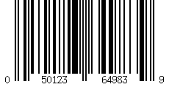
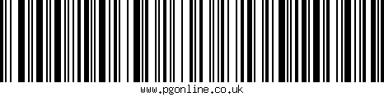
Barcode readers
Two common types of barcode system:
Universal Product Code version ‘A’ (UPC-A)
Used in retail and warehousing
Code 128
Used in transport and shipment tracking
Code 128 can represent letters and numbers whilst UPC-A can only represent numeric digits

Slide 7
UPC-A systems
This uses long guard bars to show the start and end of the barcode and also central guard bars to distinguish left uniquely from right
UPC-A uses seven bar elements to form four alternating dark and light bars of varying thicknesses to represent each data item between the guard bars
Left: Manufacturer number
Right: Product number

Slide 8
UPC-A barcode anatomy
Start
Check digit
Left Right
Guard bars
 |  |  |  |  |  |  | 3
 |  |  |  |  |  |  | 3

Slide 9
Reading UPC-A retail barcodes
Visually, a grouping of two or more adjacent bars appear as a single wide bar
Right hand codes are the inverse of left hand codes
Left hand codes all have an odd number of black bars. Right hand codes all have an even number
How could this be useful?
 |  |  |  |  |  |  | 0
 |  |  |  |  |  |  | 1
 |  |  |  |  |  |  | 2
 |  |  |  |  |  |  | 3
 |  |  |  |  |  |  | 4
 |  |  |  |  |  |  | 5
 |  |  |  |  |  |  | 6
 |  |  |  |  |  |  | 7
 |  |  |  |  |  |  | 8 |  |  |  | 0
 |  |  |  |  |  |  | 9
Left Right

Slide 10
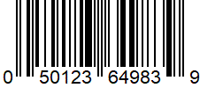
Reading barcodes
By having an odd number of black bars on one side and an even number of the right, it is possible for the scanner to work out whether it needs to read the barcode from left to right, or right to left.
This allows codes to be read when they are upside down
Why are barcodes so often used?
Direction to read code
Direction to read code

Slide 11
Why use barcodes?
Reasons barcodes are used
It is faster to scan products than enter a price in to a till
Previously, many shops would close to carry out a stock control. This is no longer necessary
Barcodes reveal a number that identifies each product. This allows a shop to determine how many items are sold which saves the need for shop workers to manually check stock levels
By having barcodes on products, prices can be changed without needing to update the price on each product
Customers are able to scan their own items, resulting in a reduced need to till operators

Slide 12
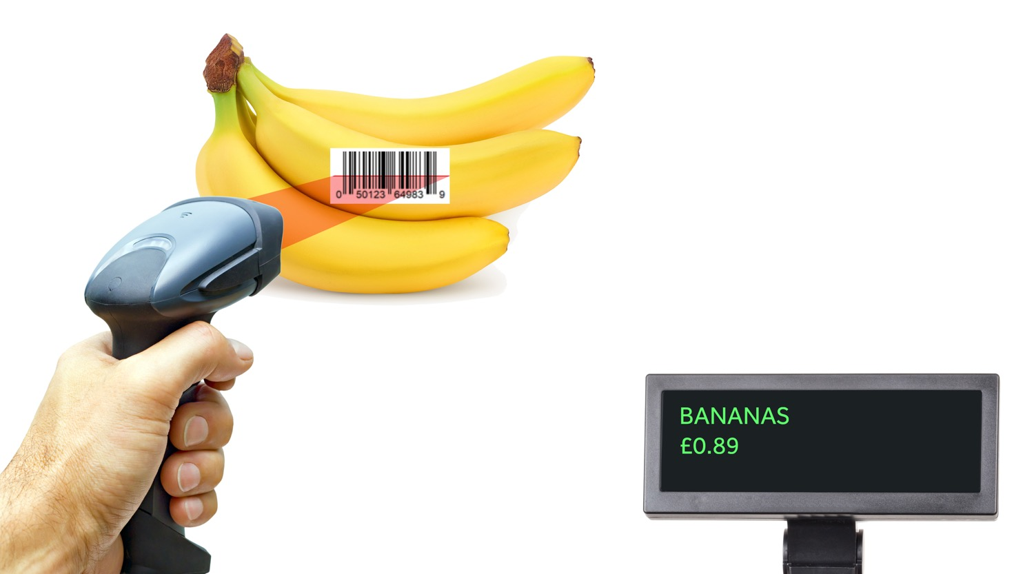
Barcode readers
Light, Light, Light, Dark, Dark, Light, Dark,…
050123649839
Product ID | Product Name | Number in stock | Price
321351050351 | Beans | 23 | 1.05
654035321354 | Celery | 12 | 0.52
050123649839 | Bananas | 45 | 0.89

Slide 13
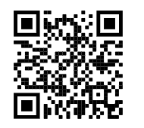
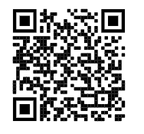
QR (Quick Response) codes
QR codes are 2D barcodes and can be read by smartphones or tablets
They can contain:
Links to websites or
Information
Try scanning these codes as examples:

Slide 14
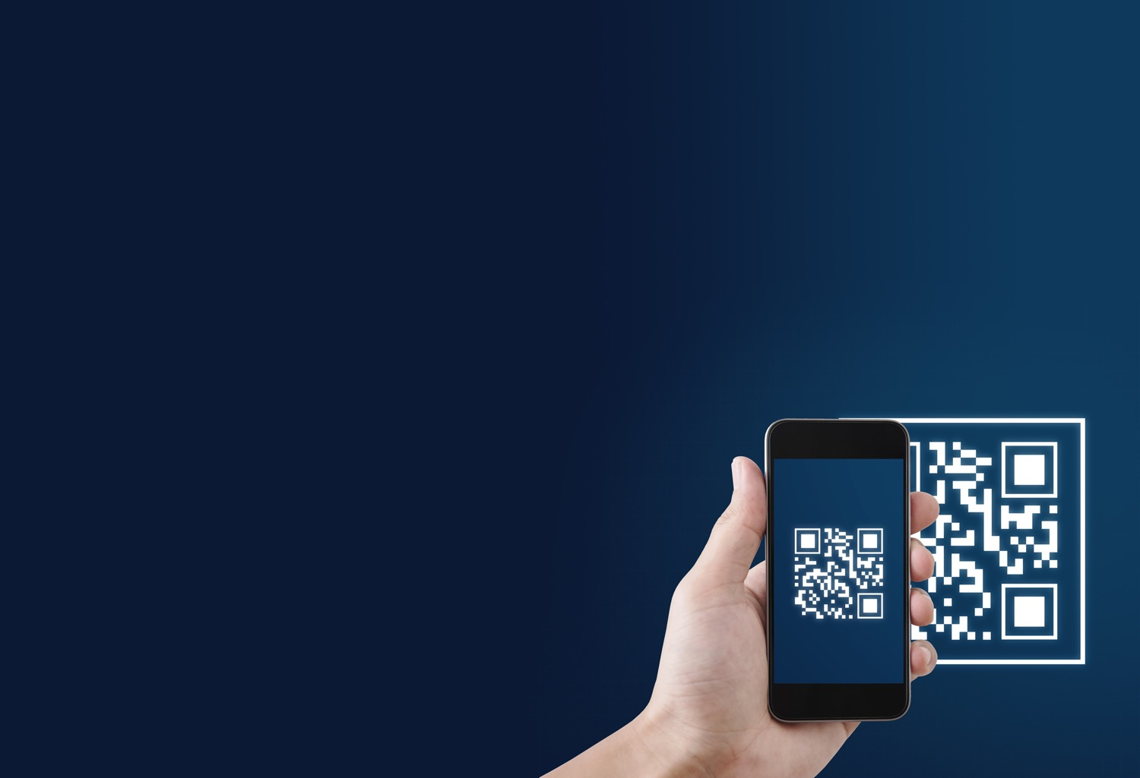

QR code scanner
QR code scanners use cameras that are built into phones or webcams
The image is processed to determine the layout of pixels which are used to store the data
The 2D arrangement of pixels allows more data to be stored than a bar code
Larger squares are located at three corners and used to align the image

Slide 15
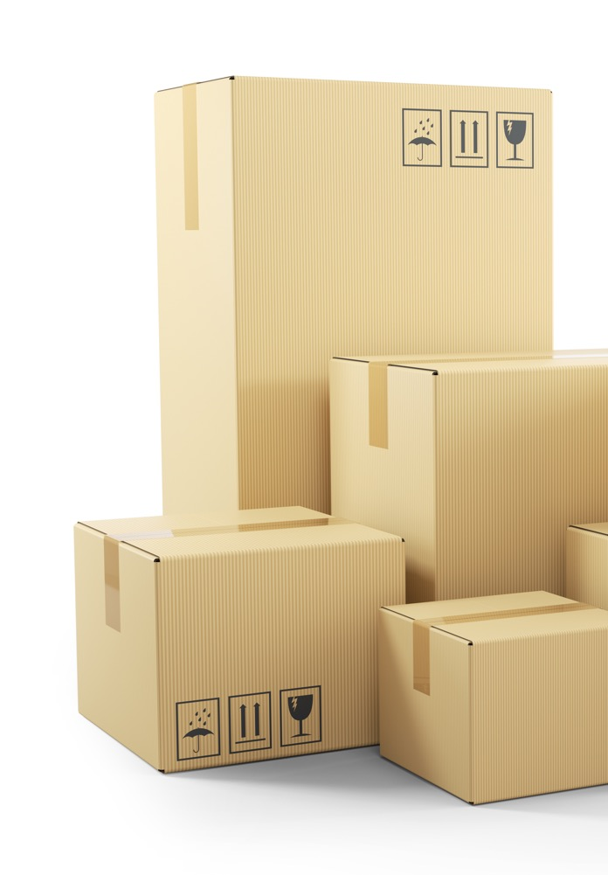
QR code uses
One example of QR code use is in allowing users to scan Wi-Fi details such as a password
This saves the user having to take time to accurately enter the password
Discuss with a partner other places where QR codes are used and why they are used in that situation

Slide 16
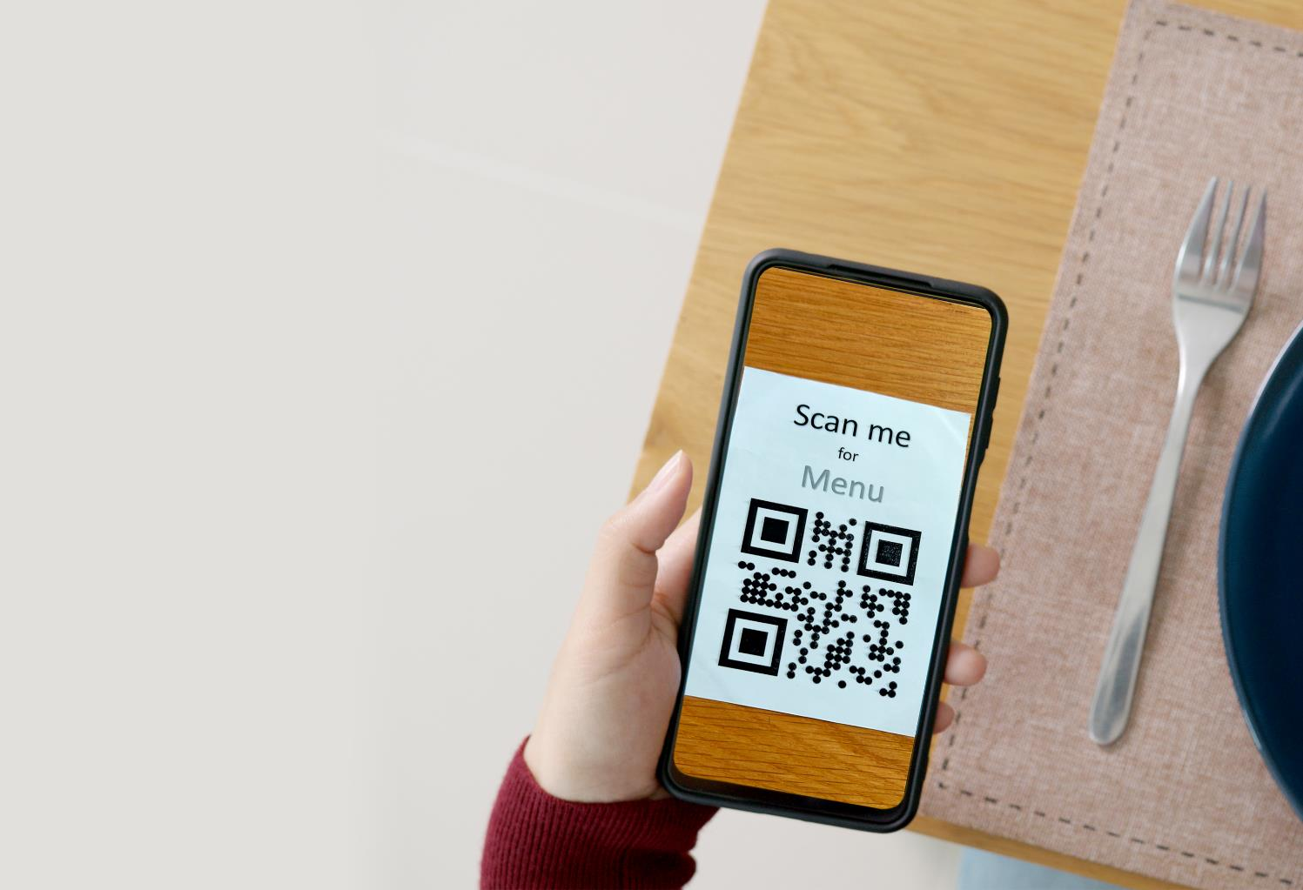
Uses of QR codes in society
Common uses include:
Tracking packages
Restaurant coupons and menus
Mobile concert tickets
Estate agency boards
Business cards
Tourist information
Advertising posters
Self service tills

Slide 17
Worksheet 2
Complete Task 1 on Worksheet 2
If your teacher asks you to, also complete Task 3.

Slide 18
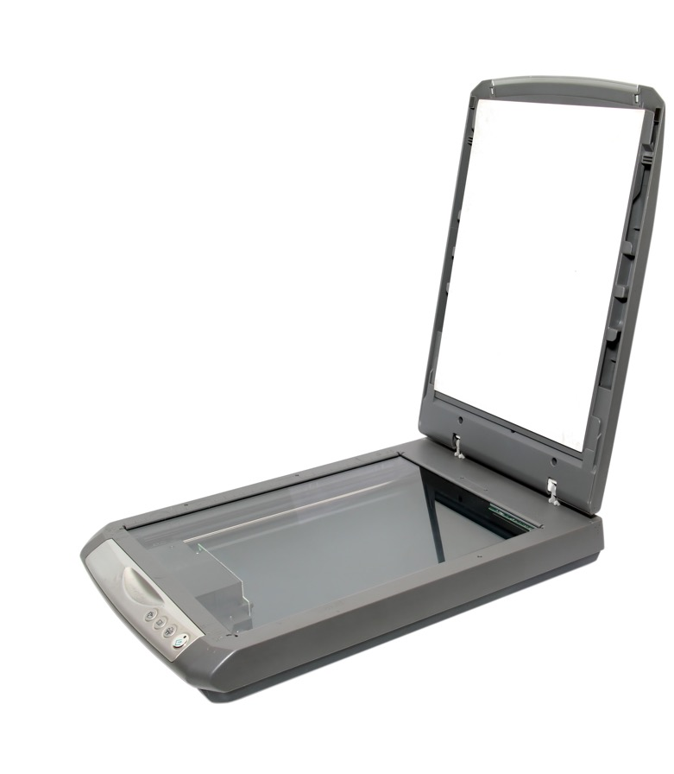
2D scanners
These are used to convert documents or photographs into a digital format. They operate as follows:
A scanner head contains a bright light and lens
The focused image then falls on to a light-sensitive sheet made up of thousands of pixels which record the light intensity or colour falling on each pixel
This information is now stored as an image in the computer’s memory

Slide 19
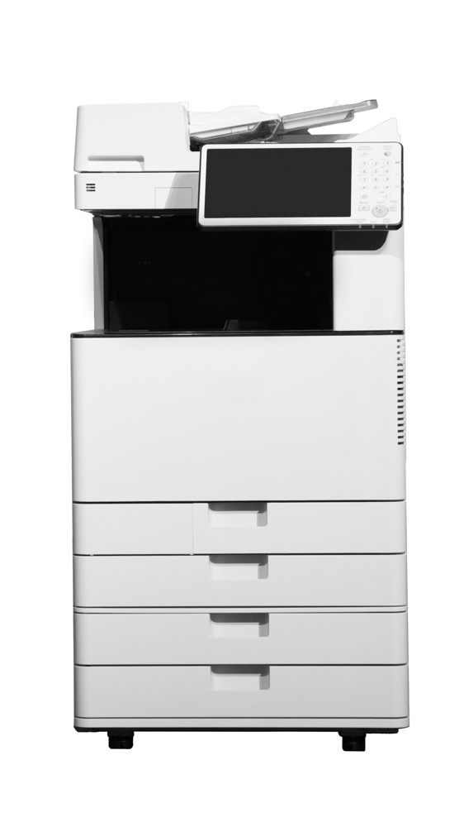
2D scanners
2D scanners are often embedded into other devices including:
Multi-function printers
Photocopiers

Slide 20
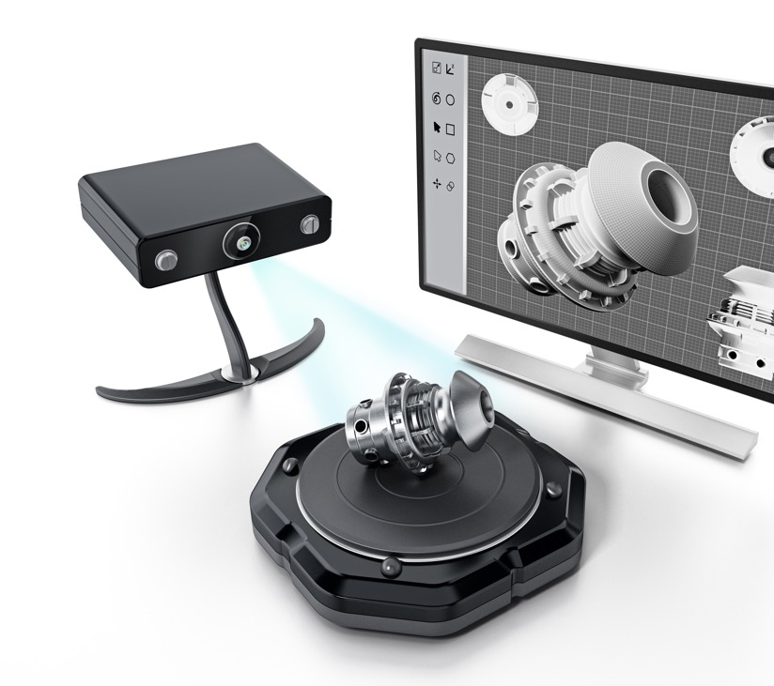
3D scanners
3D scanners use a laser to scan across an object
Two sensors detect the distance from the laser to the object
This creates a ‘point cloud’ which is then processed into a 3D representation of the object

Slide 21
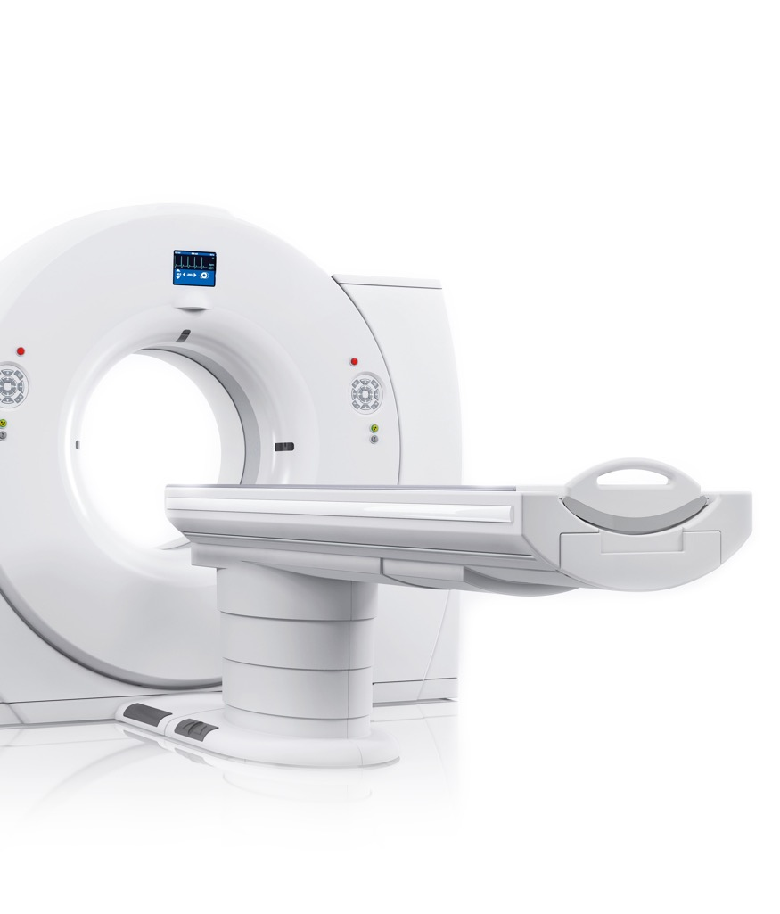
Tomography
3D scanners are used in both industrial and medical fields
Many 3D scanners rely on a technology called Tomography which involves taking images in very thin slices less than 0.1 mm thick

Slide 22
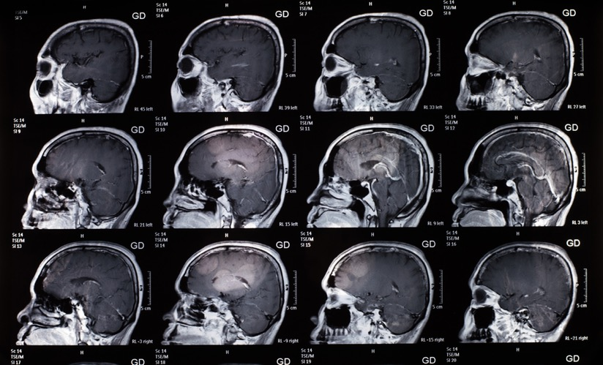
3D MRI scanning
Magnetic resonance imaging (MRI) works by taking images at many slices through the head
These may be processed into a 3D model using a computer

Slide 23
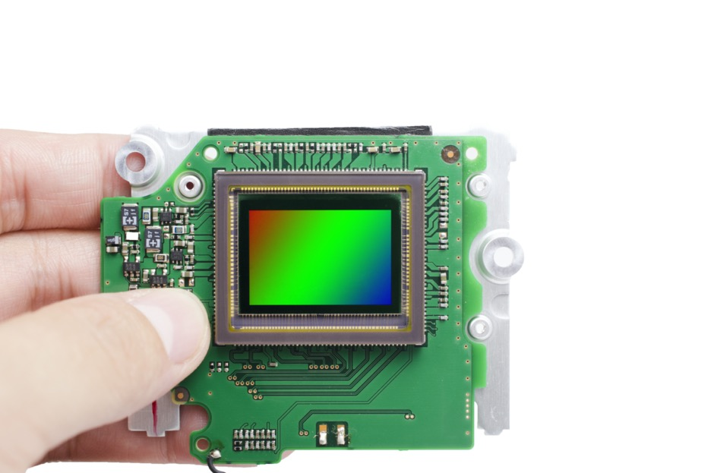
Digital cameras
Digital cameras focus light onto a CCD sensor (Charge-Coupled Device)
The CCD breaks up the image into a grid of pixels
The shutter opens to let light onto a CCD sensor at the back of the lens
A sensor measures the light intensity of each pixel
Once processed, the information is then stored as an image in the camera’s memory

Slide 24
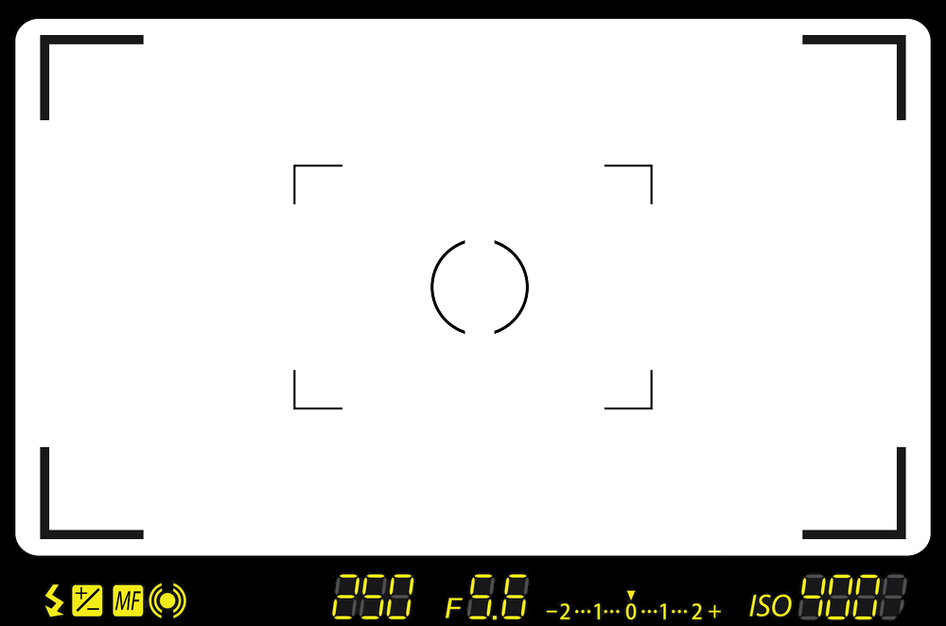
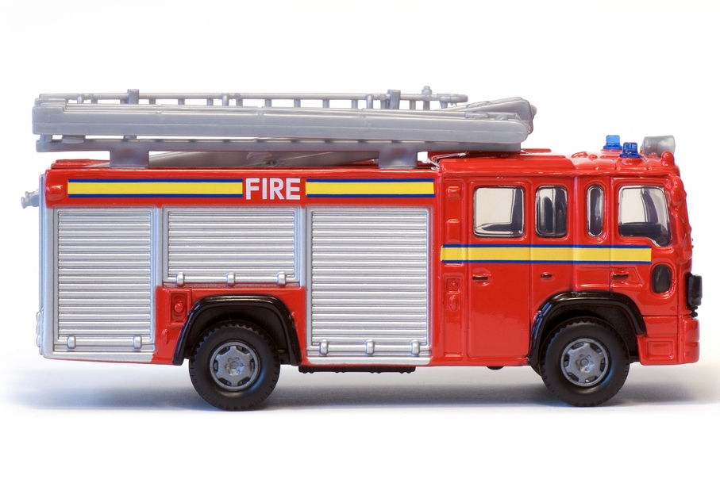
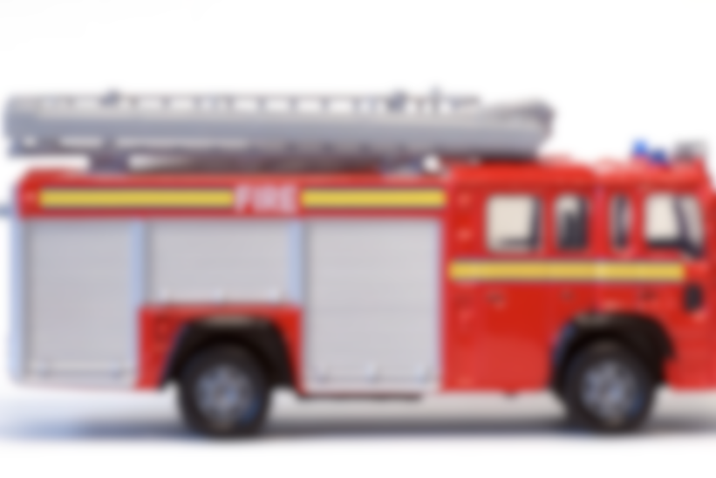
What a camera sensor sees

Slide 25
Approximating an image

Slide 26
Worksheet 2
Complete Task 2 on Worksheet 2

Slide 27
Plenary
With a partner, give at least two reasons why the following input devices are used
2D and 3D scanners
Barcode scanners
QR code readers
Digital cameras
Which technology do you think has most revolutionised our lives?

Slide 28
Plenary
2D and 3D scanners
2D: To scan photos; to photocopy; to send a fax
3D: MRI scan; scanning objects to create computer models
Barcode scanners
Checkouts; tracking packages
QR code readers
Restaurant menus; advertising; website links
Digital cameras
Photography; security cameras; video conferencing

